Slide 1
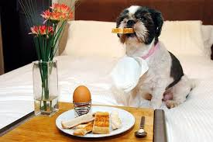
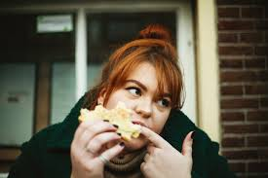
Private prayer for RCC
Take a few minutes as you eat breakfast during June to pause and pray for RCC
Pray for ministries we do have and ask God for wisdom and vision as we move forward in a post Covid world

Slide 2
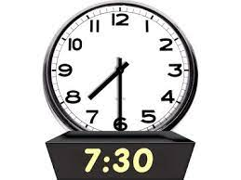
Corporate Prayer for RCC
Log into a June Zoom Prayer Time and pray with others for 30 minutes
Monday nights in June from 6:30pm to 7pm
Thursday nights in June from 7:30 to 8pm
Check the mail chimp from the Elders sent out Saturday with
log in details, it is the same as for online morning tea

Slide 3
P
R
A
Y
Drawer the symbols used for each letter
Write out your own prayer to God

Slide 4
Prayer – let’s look at Jesus
Why did Jesus pray - relationship with God

Slide 5
Prayer – let’s look at Jesus
Why did Jesus pray - relationship with God
Matthew 11:27, 28-30
“All things have been committed to me by my Father. No-one knows the Son except the Father, and no-one knows the Father except the Son and those to whom the Son chooses to reveal him.
Come to me ………

Slide 6
Prayer – let’s look at Jesus
Why did Jesus pray - relationship with God
- to know the will of God
Luke 22:39-46
⁴²“Father, if you are willing, take this cup from me; yet not my will, but yours be done

Slide 7
What time did Jesus pray
Mark1:35,
Matthew 14:19,
Luke 6:12-13

Slide 8
Position of prayer

Slide 9
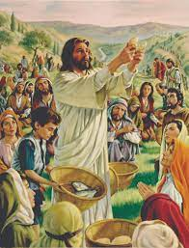
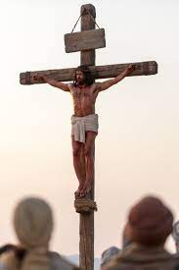
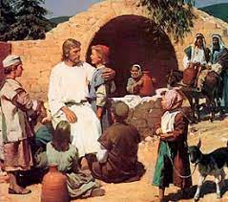
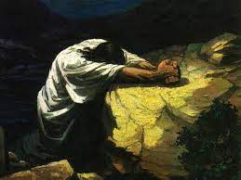
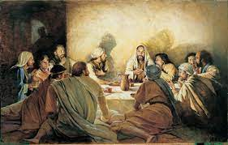
When did Jesus pray
Luke 3:21, Luke 6:12,
Mark 6:41, Matthew 19:13, John 17, Luke 22:39-46, Luke 22:34, Mark 15:34,
Luke 23:46,

Slide 10
Personal Prayer
Focus on your relationship with God
Focus on God’s will be done
Quote from the Kid’s Spot
They all wanted what God wanted more than what they wanted

Slide 11
Corporate Prayer
Pray in faith Acts 12:11-17
Share your burdens with others and pray
Email the Church and we will pray
Join us on Mondays 6:30pm / Thursdays 7:30pm

